Slide 1
Contractor, how to stay in compliance:
A guide to Rule 5 BMPs and requirements
Maryann Dugan, Kenton Ward, Andrew Wells
Indiana Watershed Leadership Academy 2014

Slide 2
Table of contents
Introduction....………………………….………………………………….1
Legislation……………………………….….……………………………….2
Steps for Compliance…………….………………………………………3
Silt fence………………………………………...………..………………….10
Hay bales………………….…...……………………………….………….….19
Rock check dams....…...………………………………………………..….23
Inlet control measures………………………………………………28
Concrete washout…………………………………………………...…..34
Construction entrance and exit………………………………...38

Slide 3
Introduction
This hand book is intended to be a field guide for assistance in Rule 5 compliance on the jobsite. It is not intended as an all-inclusive guide. The Best Management Practices (BMPs) included in this book are the most frequently used and violated. Additional BMPs may be employed for applicable jobsites.

Slide 4
Legislation
Rule 5 is covered under 327 IAC 15-5.
Rule 5 establishes requirements for storm water discharges from construction activities.
Rule 5 permits only apply to construction activity of one acre or more, but all projects require BMPs to prevent runoff violations.
The Indiana Department of Environmental Management (IDEM) provides the Step by Step Process for compliance with 327 IAC 15-5 at www.in.gov/idem/5419.htm
The Indiana Department of Environmental Management (IDEM) administers Rule 5 in cooperation with the local Soil and Water Conservation Districts (SWCDs) unless the community has been required by IDEM to become a Municipal Separate Storm Sewer System (MS4)
An MS4 has to meet the requirements of 327 IAC 15-5 but can also mandate additional local requirements

Slide 5
Steps for compliance
Step 1
  Develop a Construction Plan for the project. Every site is different, so careful planning and assessment is necessary for each site.
  The requirements for the Construction Plan are detailed at 327 IAC 15-5-6.5. The 23 basic plan elements that must be included in the Construction Plan are detailed at www.in.gov/idem/4909.htm.
  The integral part of the Construction Plan is the Storm Water Pollution Prevention Plan (SWPPP).
  The SWPPP must address how erosion and sedimentation will be controlled on the site to minimize the discharge of sediment off-site or to the waters of the State.
  The SWPPP needs to address other pollutants associated with construction such as disposal of building materials, fueling operations, concrete pouring, concrete washout, keeping public roads free of mud and sediment, etc.

Slide 6
Steps for compliance
Step 1 continued
  The SWPPP must address pollutants associated with the post construction land use.
  Erosion control practices shall be IAW the IDEM Storm Water Quality Manual dated October 2007 and the National Resources Conservation Service Field Office Technical Guide.
  The IDEM Storm Water Quality Manual can be found at www.in.gov/idem/4899.htm. (Chapters 7 and 8 most applicable for BMP specific guidelines)
Step 2
  Submit the Construction Plan to the review authority.
  On the Step-by-Step Process for Compliance website, Step 2 has a link to determine the review authority for the county/district where construction will occur.

Slide 7
Steps for compliance
Step 3
  Publish a notice of the pending construction in a newspaper of general circulation in the project area IAW 327 IAC 15-5-5(9).
  The review authority will provide a written notice that the Construction Plan meets the requirements of 327 IAC 15-5, is deficient or was received and the review waived.
Step 4
  Submit a copy of the Notice of Intent (NOI) to IDEM and to the review authority. The Step by Step Process website provides a link to obtain a writable blank NOI form.
  Along with the NOI, the following must also be submitted:
    -Proof of Publication in a regional newspaper
    -Copy of the verification of the reviewing authority acceptance of the Construction Plan
    -Any fees
5

Slide 8
Steps for compliance
Step 5
  Construction activities may begin 48 hours following the receipt of the NOI by IDEM and the review authority, whichever is the latest.
  If the date of land disturbance is different than the date on the NOI, IDEM and the review authority must be notified 48 hours prior to the actual date of land disturbance. The Step-by-Step Process provides a link to get the email and phone number for the IDEM Permits Coordinator to provide the official notification of this change.
Step 6
  Implement the Construction Plan including the SWPPP throughout the life of the project. The plan must be implemented before, during and after construction activities occur.
6

Slide 9
Steps for compliance
Step 6 continued…
  A trained individual knowledgeable in storm water management and experienced in erosion control methods must complete a required written self-monitoring evaluation of the project site and the functioning of the storm water quality measures. These written evaluations must be completed at a minimum one time per week and by the end of the next business day following a measurable storm event of 0.50” or more. These evaluation reports must be made available for review by the review authority.
  The review authority has the authority to inspect the site throughout the life of the project. The review authority has the authority to stop the construction activities or place a fee or fine on the builders if erosion controls are not adequate.
  If the SWPPP is not sufficient to prevent pollutants including sediment from discharging from the site, the plan must be modified to stop this discharge. If significant changes are required, it is prudent to review the changes with the review authority.
7

Slide 10
Steps for compliance
Step 7
  A uniform perennial vegetative cover with a density of 70% without any large bare areas must be established to consider final stabilization.
  All building materials, spoils, waste and erosion control measures must be removed for the project to be considered complete.
  Once all permanent storm water quality measures have been implemented and are operational, a Notice of Termination (NOT) must be submitted to IDEM and the review authority.
  The Step by Step Process website provides a link to obtain a writable blank NOT form.
8

Slide 11
Steps for compliance
Additional
  Storm water erosion controls must be in place prior to disturbance of any land!
  Construction activities that measure less than an acre will not be required to obtain a Rule 5 permit but best management practices includes erosion and sediment control measures will be required to prevent discharge of disturbed land to an adjacent property or the waters of the State.
  Dewatering operations will be completed to prevent loss of dislodged soil. A device such as a filter sock will be placed on the end of all hoses to prevent discharge of dislodged soil or sediment.
  Temporary or permanent surface stabilization is required on any un-vegetated areas that are scheduled or likely to remain inactive for a period of seven (7) days or more except as prevented by inclement weather or other exceptional circumstance. Surface stabilization methods are available in the IDEM Storm Water Quality Manual.
9

Slide 12
Silt fence
Installation
  Proper use of silt fencing requires proper installation and ongoing maintenance. Silt fences must be trenched-in and joined at the edges properly. If a silt fence is not functioning properly or at all, it must be repaired or replaced with another BMP.
10

Slide 13
Silt fence – installation
Geotextile
Fabric
Water Flow
Stake
Fill dirt
Fabric laid under trench
11

Slide 14
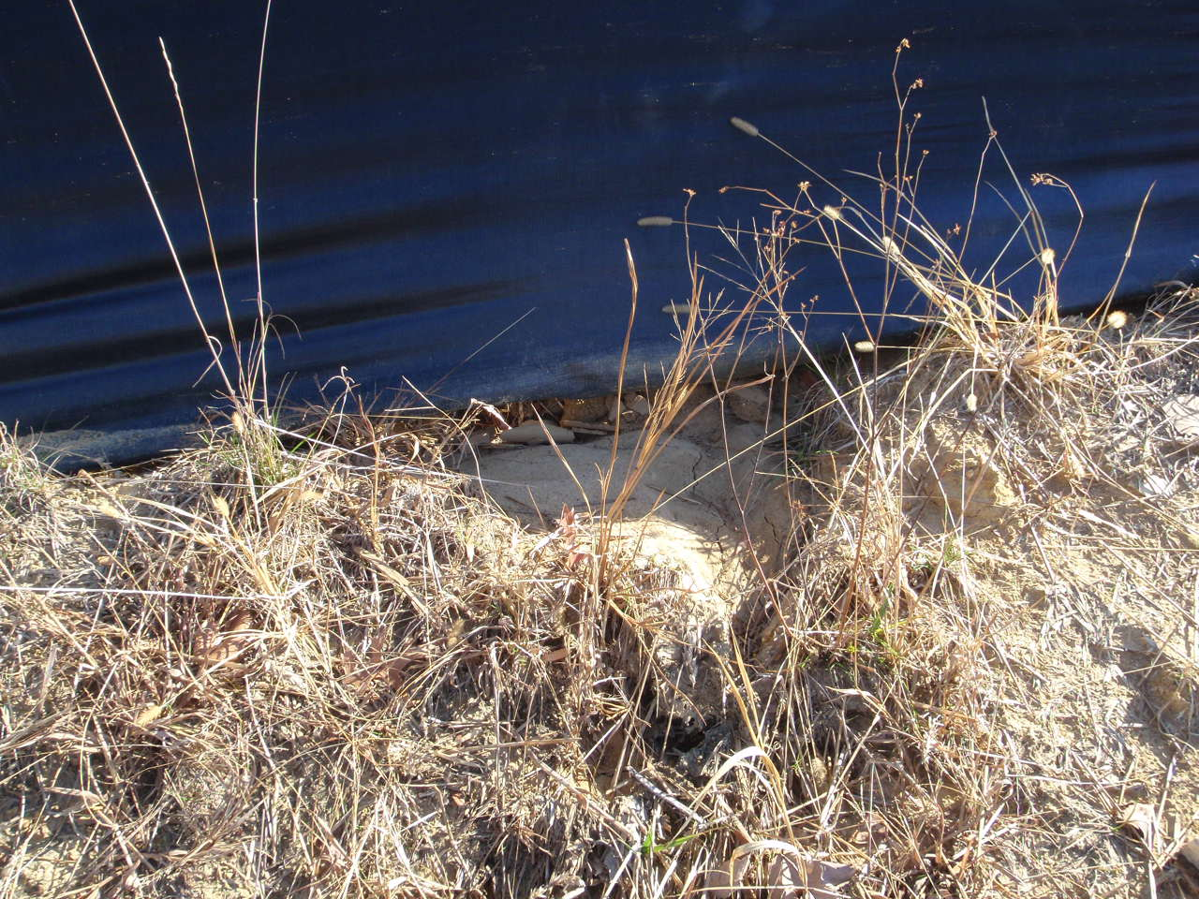
Silt fence - trenching
The gap beneath this improperly installed silt fence has allowed sediment to flow under it.
12

Slide 15
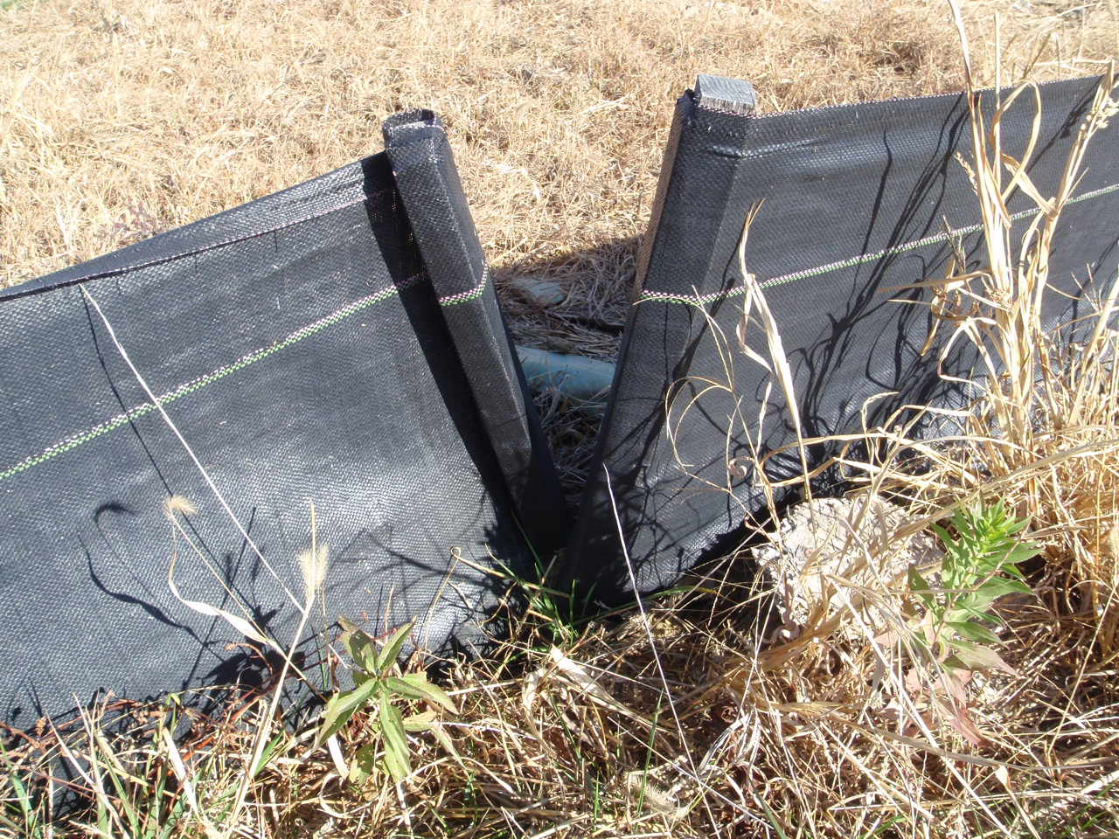
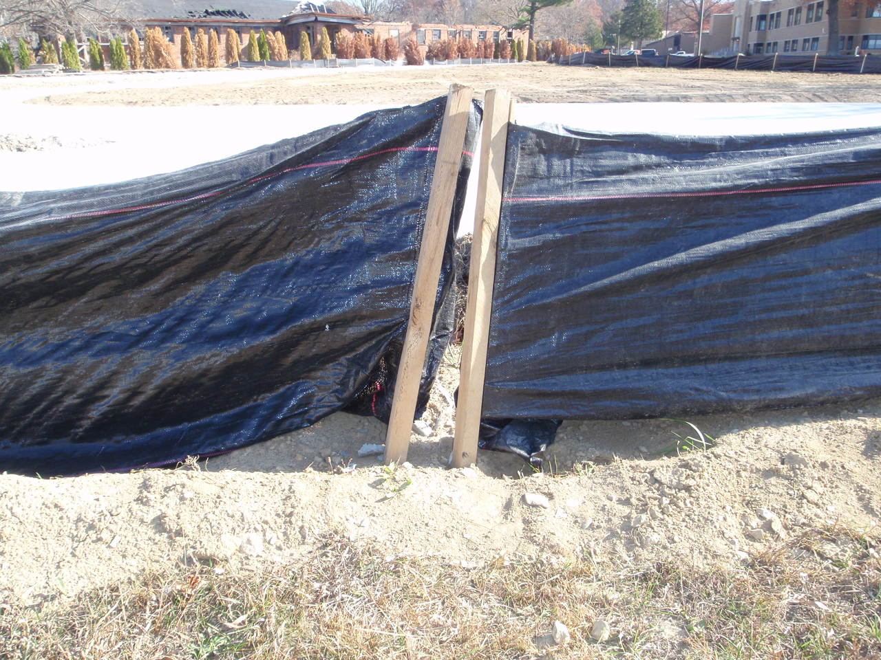
Silt fence – edge joining
These two silt fences are not properly joined at their ends.
13

Slide 16
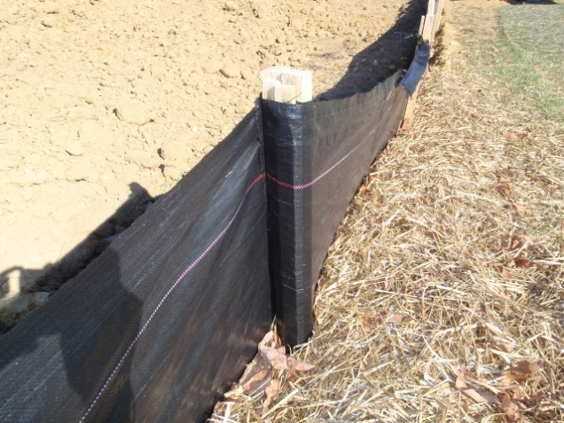
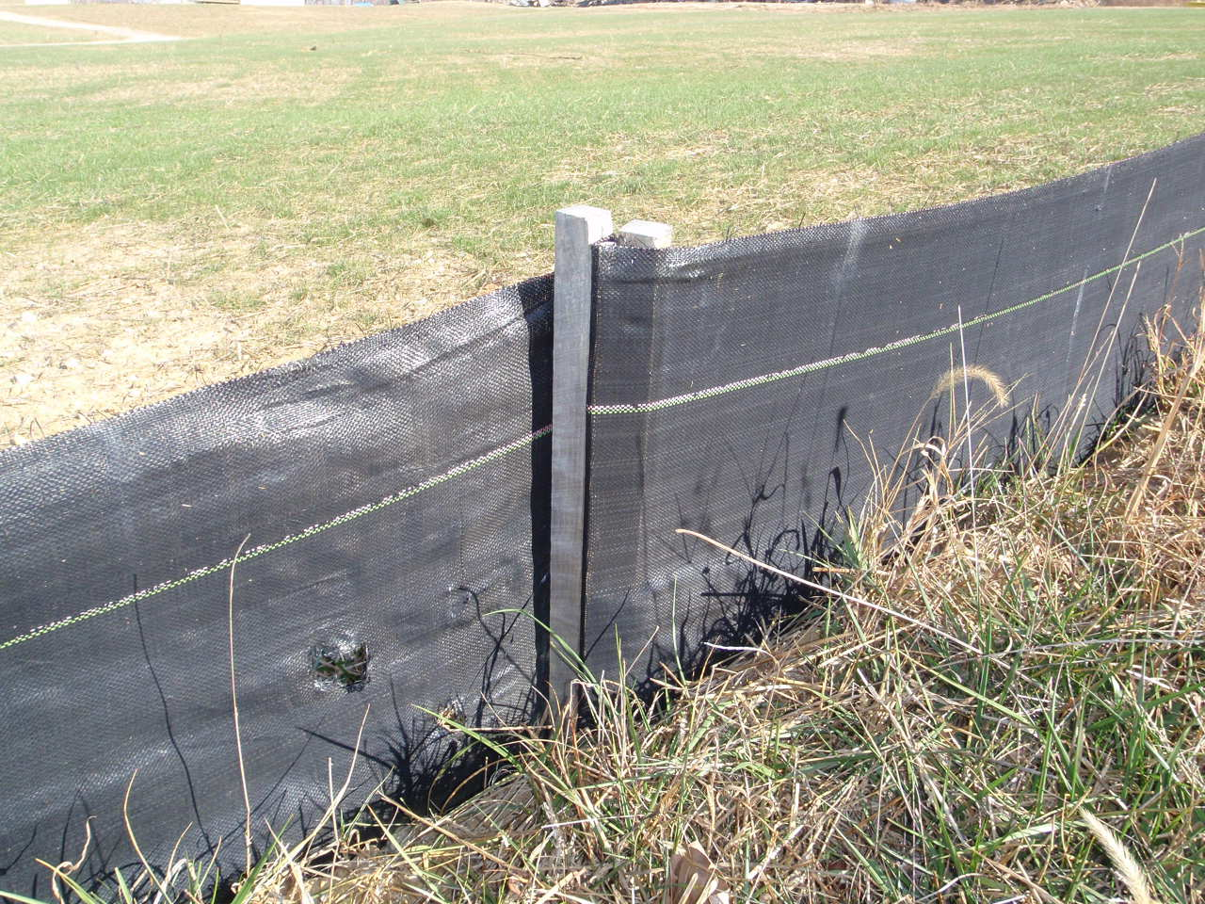
Silt fence – edge joining
Geotextile
Fabric
These two silt fences are properly joined at their ends by wrapping.
Stake
14

Slide 17
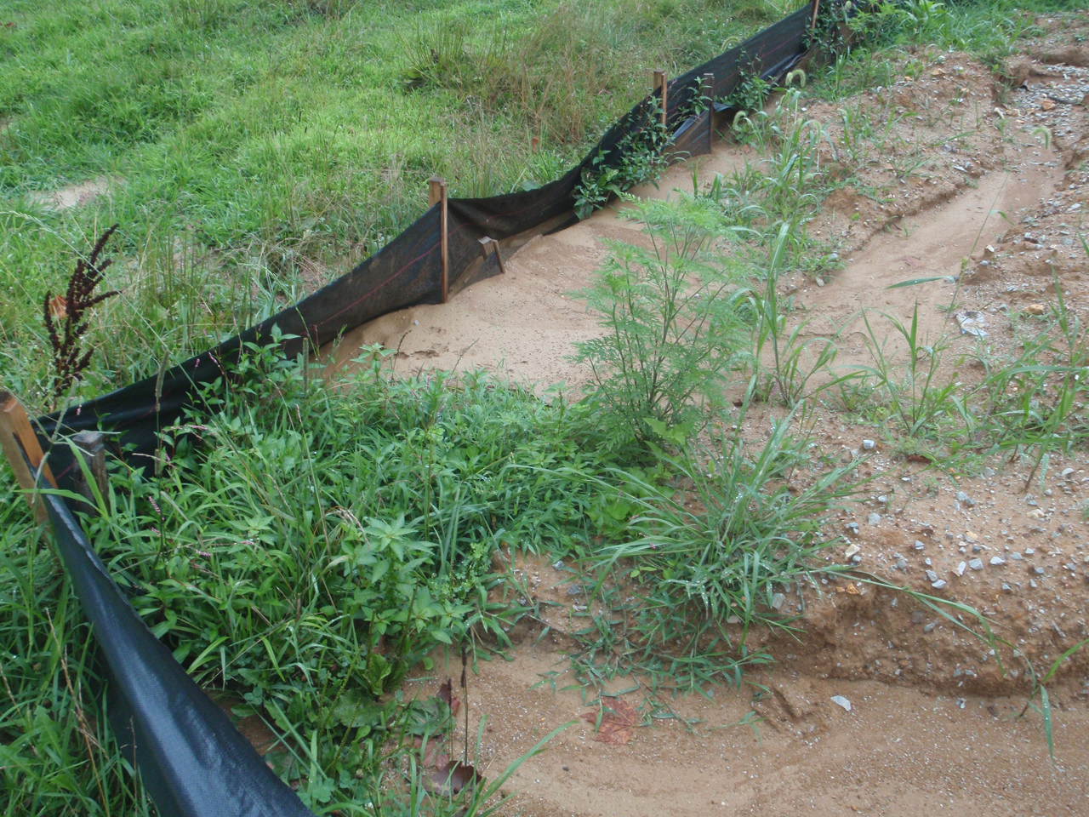
Silt fence - maintain
This silt fence requires maintenance. sediment needs to be removed upon collection to keep the fence from being overwhelmed.
15

Slide 18
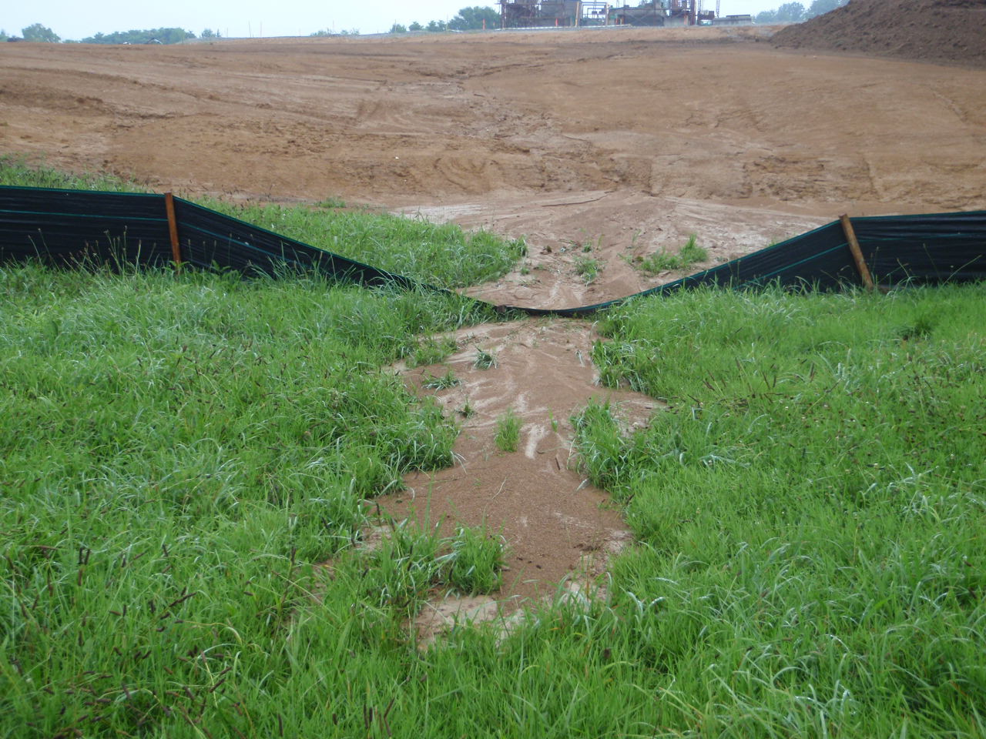
Silt fence - repair
This silt fence has been breached. The collected sediment needs to be removed. The fence needs repair and reinforcement.
16

Slide 19
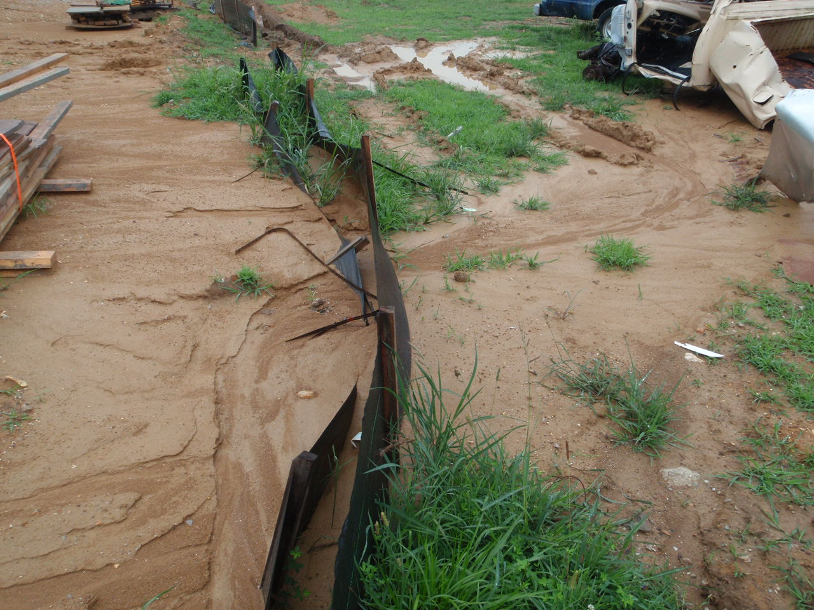
Silt fence - replace
The double silt fence repair here has again failed. This silt fence BMP is ineffective and needs to be replaced with a better BMP.
17

Slide 20
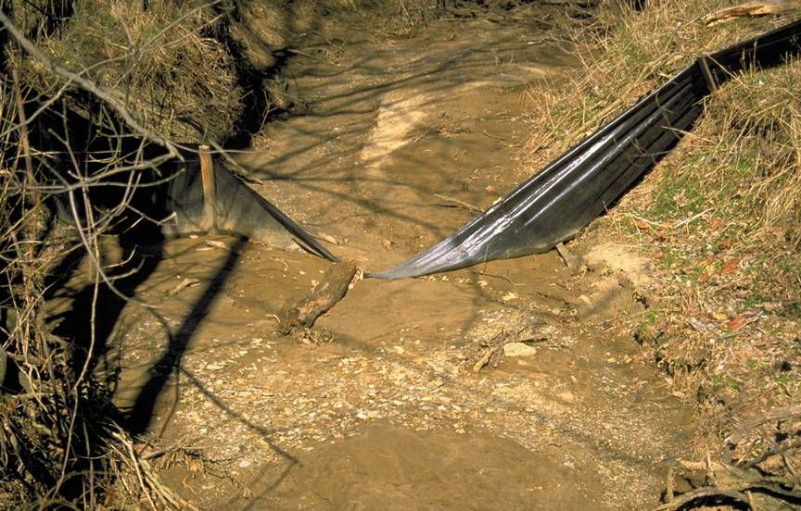
Silt fence - note
Silt fencing should not be installed in high flow areas. A more effective BMP should be used.
18

Slide 21
Hay bales
Installation
  Hay bales need to be laid on their sides to extend the life of the bindings. Two stakes are required to hold the bale in place. Where two bales are laid end to end, a third bale should be placed behind the gap of the first two. Hay bales should be trenched into the surface a couple of inches. Hay bales should not be used in high flow drainage areas or as check dams.
19

Slide 22
Hay bales – installation
Top Profile
Side Profile
Stake
Bale
Binding
Water
Flow
20

Slide 23
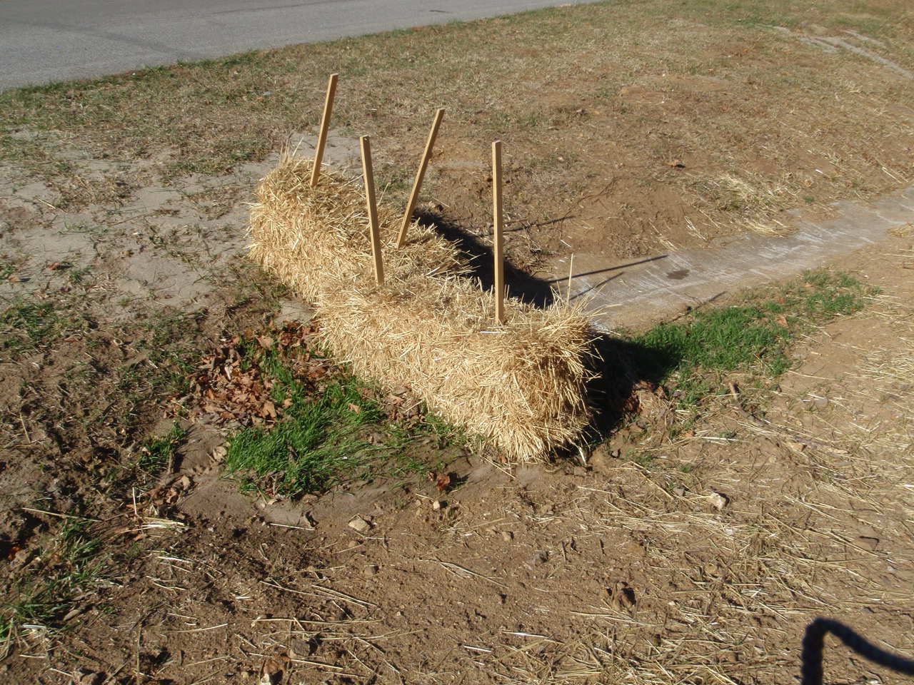
Hay bales – installation
These overlapping hay bales are not as effective as a third bale reinforcing the other two. Hay bales are cheap, but if not used properly they may cause problems and additional BMPs may cost more.
21

Slide 24
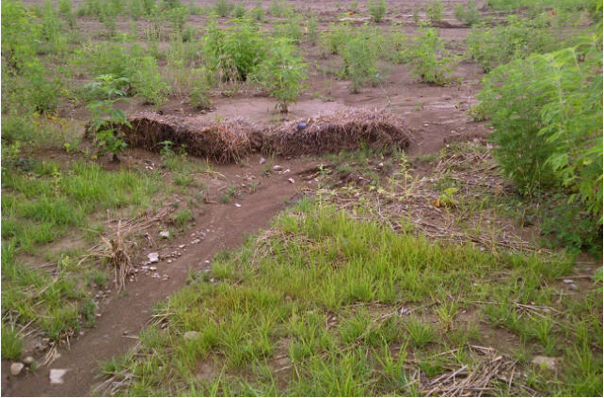
Hay bales – maintenance
Check hay bales frequently and repair or replace as necessary. These hay bales are failing and need replacement.
22

Slide 25
Rock check dams
Installation
  Rock check dams can be used in drainages on gentle to steep slopes. The idea is to not allow the water to gain velocity and cause erosion. Specifications for check dams include geotextile fabric, riprap, and filter stone. Check dams on steep slopes should be sequenced to control the speed of water on the entire slope.
23

Slide 26
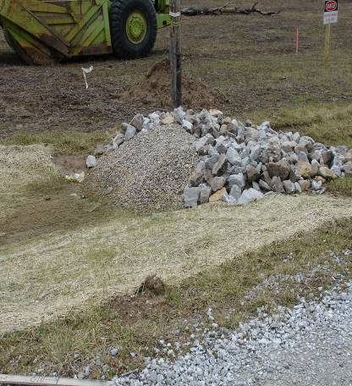
Rock check dams
A rock check dam in a drainage on a gentle slope.
24

Slide 27
Rock check dams – materials
Filter Stone
Riprap
Water Flow
Geotextile
Fabric
25

Slide 28
Rock check dams – sequencing
Rock check dams in a drainage on a steep slope. Sequencing of rock check dams on a slope should be from the crest of the bottom dam to the toe of the next higher dam.
26

Slide 29
Rock check dams – sequencing
Toe
Crest
Toe
Crest
27

Slide 30
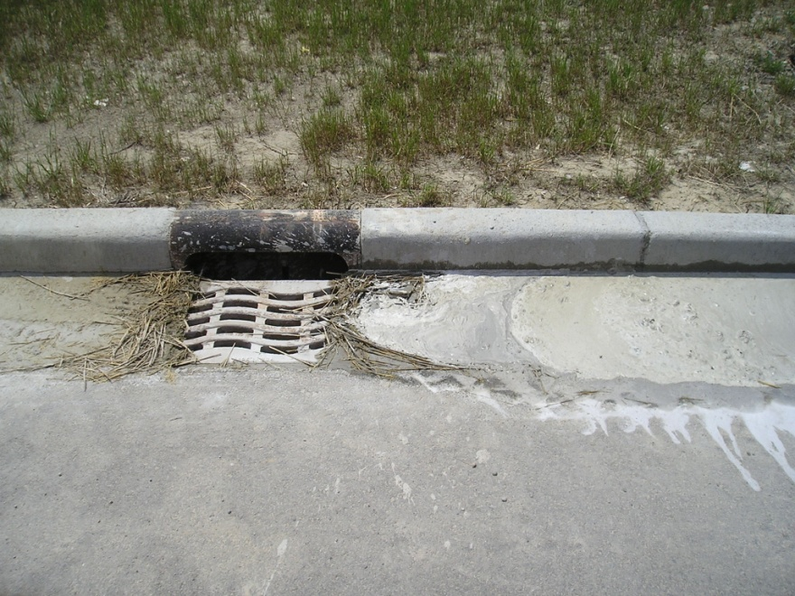
Inlet control measures
Do not forget to protect the storm sewer inlets during the construction process! These need protection from storm water runoff carrying sediment and debris.
28

Slide 31
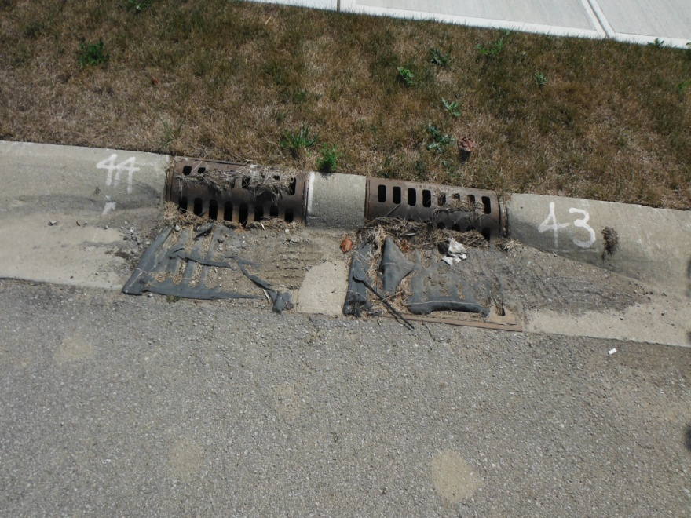
Inlet control measures
Geotextile fabric mats help to filter sediment out of construction runoff. These mats need to be maintained and may be overwhelmed during a heavy rain storm.
29

Slide 32
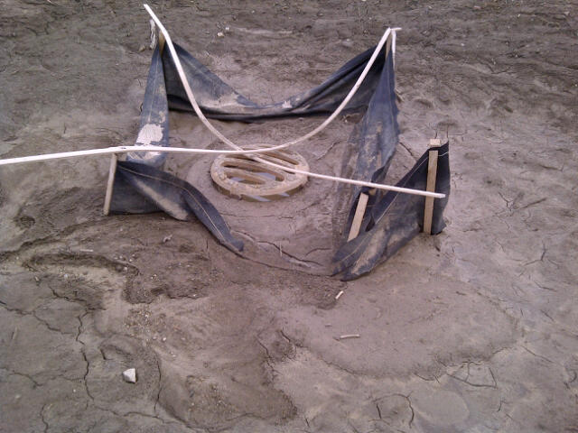
Inlet control measures
This poorly maintained inlet control BMP was not robust enough for storm water flow. It has become clogged with sediment.
30

Slide 33
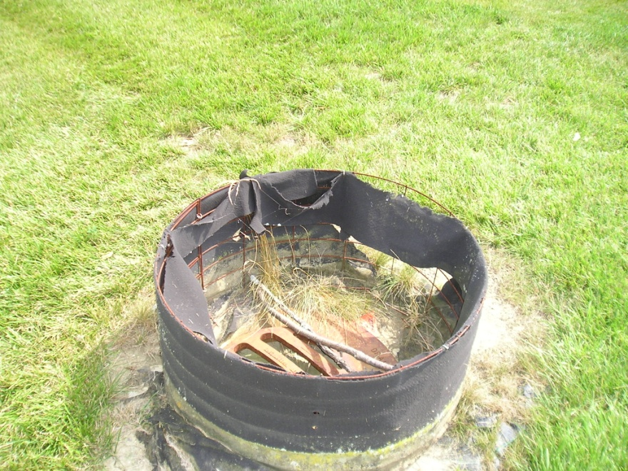
Inlet control measures
Wire fencing reinforcement of the geotextile fabric works better than wood stakes. However, the fabric at the base of this BMP is not fully protected and has failed.
31

Slide 34
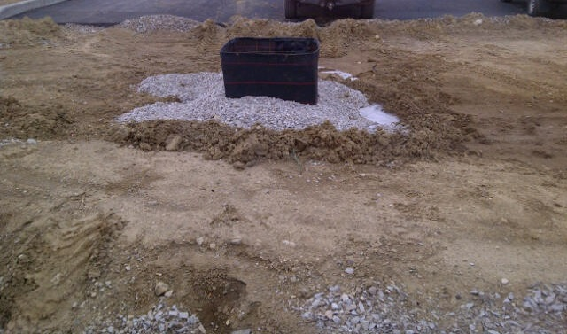
Inlet control measures
This inlet control BMP has geotextile fabric reinforced with wire fencing and the base of the fabric is surrounded by filter stone. This BMP will withstand a heavy rain event.
32

Slide 35
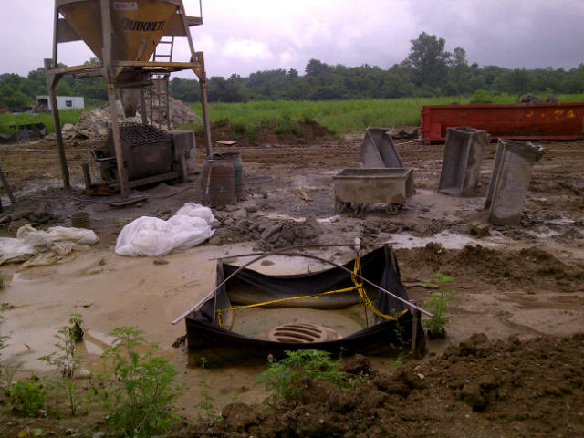
Inlet control measures
Try to avoid concrete mixing next to storm drain inlets. Especially, next to inlets with failing BMPs.
33

Slide 36
Concrete washout
Concrete waste and rinse water cannot be dumped on the ground. The chemicals in concrete can leach into ground and surface waters. These chemicals can raise the pH levels in water that harm plants and animals. Concrete washout pits should be placed at least 50 feet from any waterways or inlets. Access points should be stabilized and the location marked with signage. The washout should be surrounded with sandbags or hay bales to contain the waste and lined with a 10 mil thick minimum plastic sheeting.
34

Slide 37
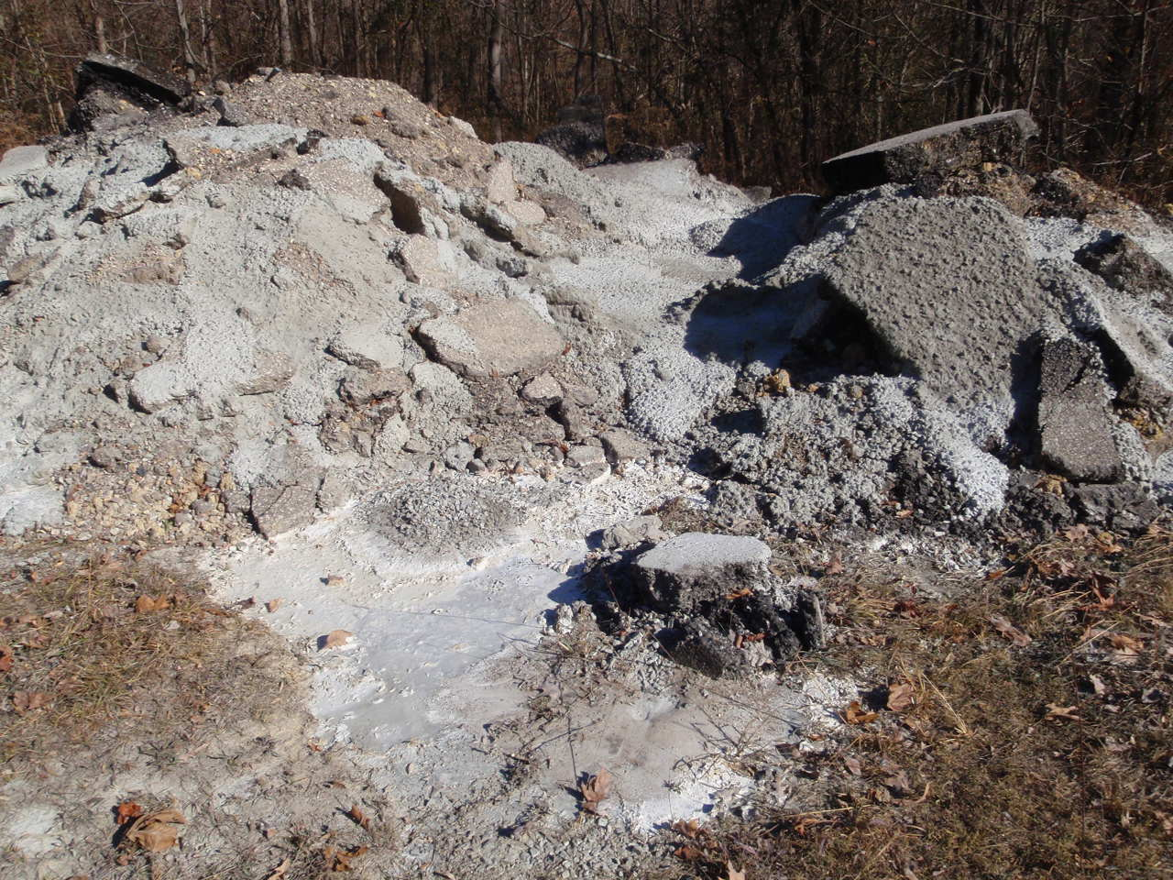
Concrete washout
Concrete waste and washout cannot be dumped on the ground. This can be a serious Rule 5 violation.
35

Slide 38
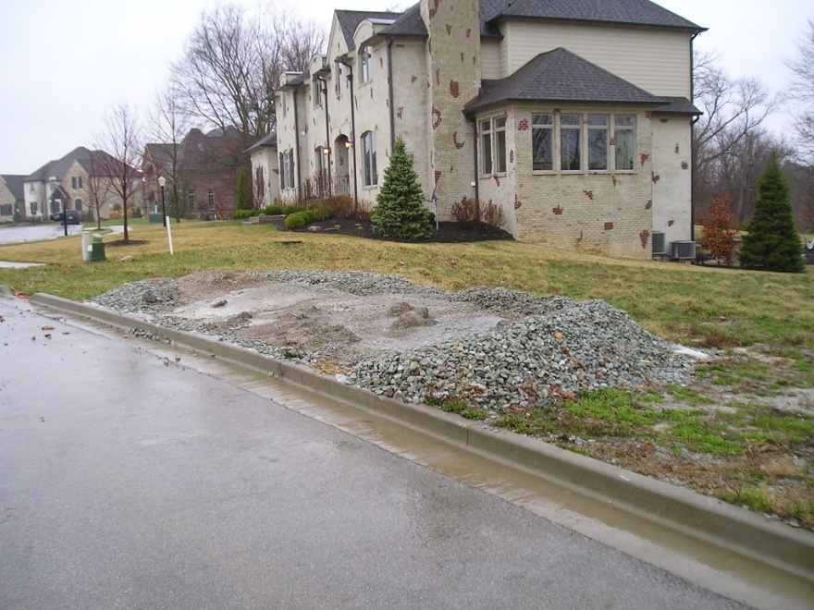
Concrete washout
Gravel can be used as a perimeter support, but without a plastic liner, liquids can seep through.
36

Slide 39
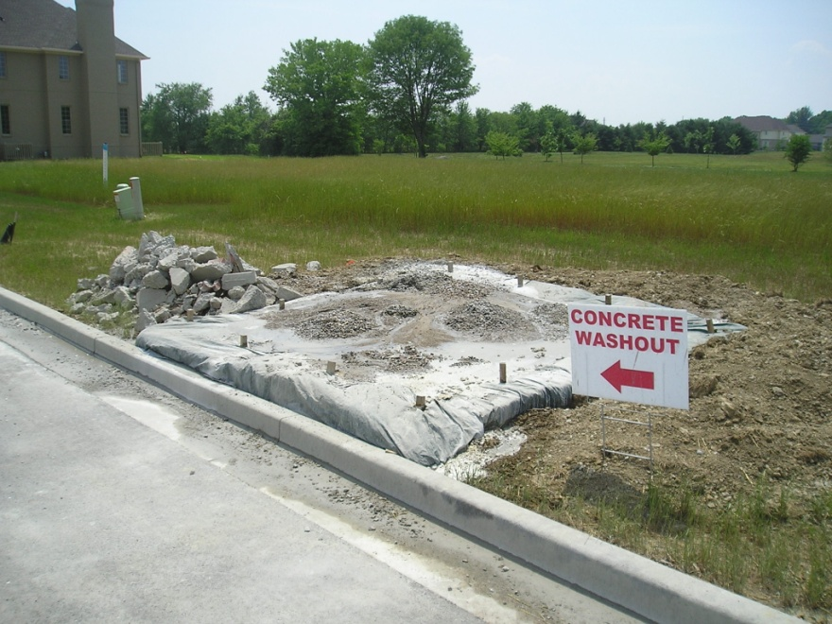
Concrete washout
This is a proper concrete washout. The pit is surrounded and supported by hay bales staked down. It is lined with plastic sheeting. Access to the area is on a stable surface and the pit is properly marked.
37

Slide 40
Construction entrance & exit
Construction areas need to have proper entrance and exit points which limit the transfer of mud and debris onto roads. On smaller sites, this entrance and exit can be the same area. The purpose of this is to create a stable surface that will knock-off excess mud when vehicles and equipment leave the site. These entrance and exit points should be marked with signage. Tracking dirt onto roads is considered the same as sediment leaving the construction area as with storm water runoff. If mud and dirt are tracked onto roads, it needs to be cleaned off. This removal is done by mechanical means and not washed down the nearest storm drain. A good rule is, if it is mud, do not drive on it.
38

Slide 41
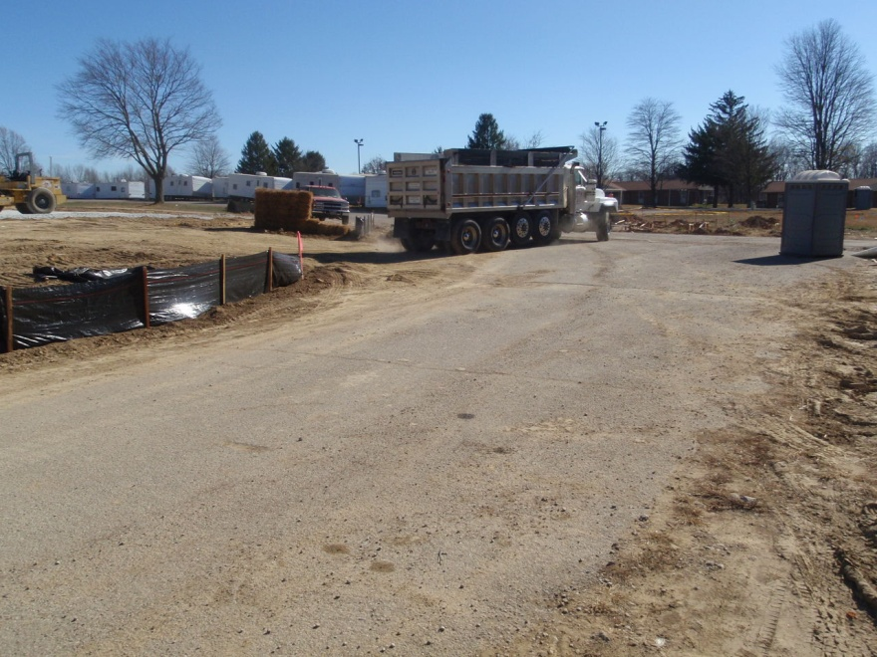
Construction entrance & exit
This hard packed dirt construction exit will be thick mud after the next heavy rain.
39

Slide 42
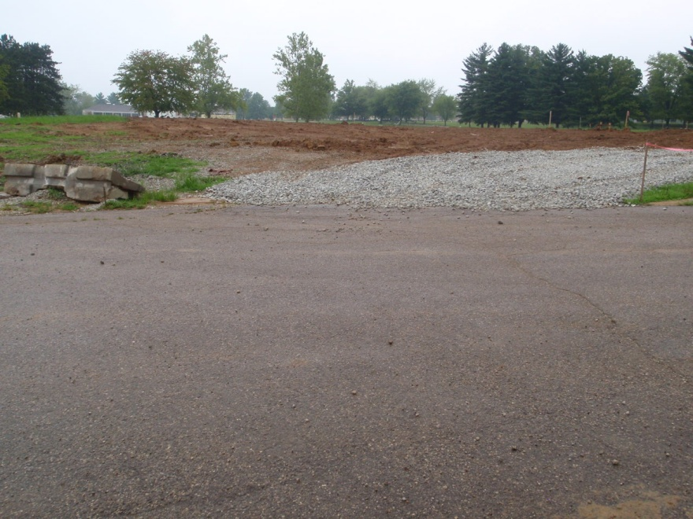
Construction entrance & exit
Hard packed gravel is a better choice. This will limit mud leaving the construction site. The gravel will also help to protect against surface runoff as a silt fence here would be impractical with the vehicle traffic.
40

Slide 43
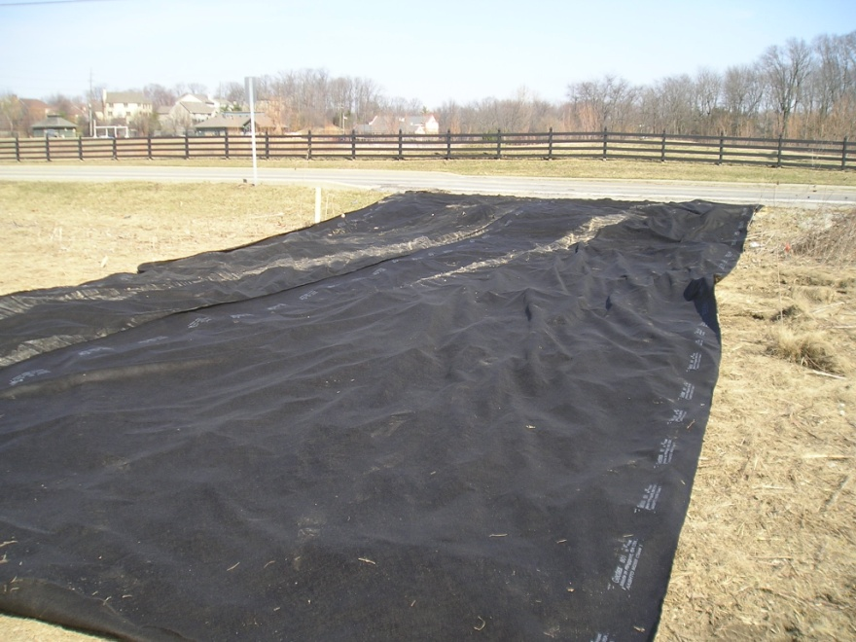
Construction entrance & exit
Select an appropriate area and line the bottom with geotextile fabric for support. Hard packed filter stone will go on top of this fabric.
41

Slide 44
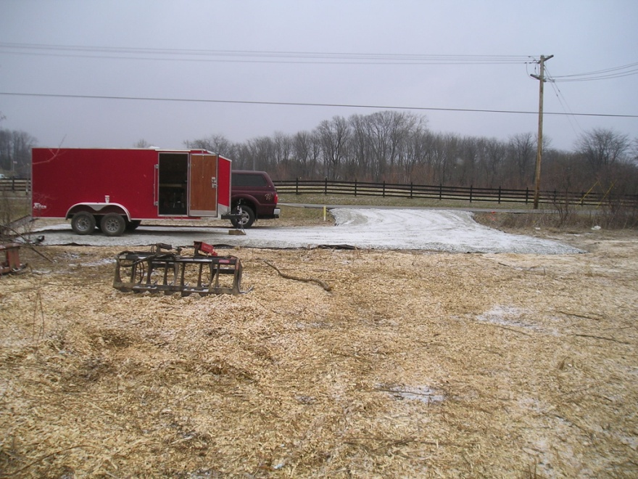
Construction entrance & exit
This is a proper entrance and exit point. Not only will it prevent sediment from leaving the site, but it has been expanded to keep parked and stored equipment out of the mud.
42

Slide 45
Notes
______________________________________________________________________________________________________________________________________________________________________________________________________________________________________________________________________________________________________________________________________________________________________________________________________________________________________________________________________________________________________________________________________________________________________________________________________________________________________________________________________________________________________________________________________________________________________________________________________________________________
43

